Slide 1
Amazon sales data analytics
FINAL PROJECT REPORT
SUBMITTED BY
KRISHNANUNNI BR

Slide 2
INTRODUCTION
In today's highly competitive business landscape, effective sales management has become crucial for organizations aiming to optimize distribution methods, minimize costs, and enhance profitability. With the exponential growth of e-commerce platforms like Amazon, analyzing sales data has emerged as a pivotal strategy for understanding consumer behavior, identifying market trends, and making informed decisions.
This project aims to perform an ETL (Extract-Transform-Load) analysis on an Amazon sales dataset to uncover valuable insights related to sales trends. The focus will be on analyzing sales data on a month-wise and year-wise basis, as well as a detailed yearly_monthly analysis. By transforming raw sales data into a structured format, we will extract meaningful metrics and relationships among various attributes that influence sales performance.
By understanding sales trends and identifying key factors that drive performance, businesses can refine their sales strategies, enhance customer targeting, and optimize inventory management. The insights derived from this analysis will empower stakeholders to make data-driven decisions, ultimately contributing to improved sales outcomes and sustained competitive advantage in the marketplace.This project will leverage advanced analytical techniques and tools to provide a comprehensive overview of Amazon's sales dynamics, offering actionable insights for sales management and strategic planning.
.

Slide 3
Extract-Transform-Load
Extract: Sources of data (e.g., 100 Sales Records, Products, customers, region, division, Amazon Food Category etc.).
Transform: Data cleaning and shaping in Power Query.
- promoted Headers and changed data type of columns
- performed complex steps to modify order date column into required date column format
- renamed country name from "Cote d'Ivoire ” to "Cote d voire ", to match currency table with newly added exchange rate column name inorder to create relationships with these tables
- relaced null values with 0 in discount amount column in amazon food category table
- created new column named ‘Discount amount modified’ and performed queries to removed negative values from the discount amount column
Load: Loading transformed data into Power BI for analysis

Slide 4
DATA MODELLING
The inspection of the data revealed the characteristics of the numerous features in addition to the tendencies and distribution of the data.
As such, it was found that there were no null values in any of the columns.
Moreover, the feature columns were also not multi-collinear i.e. strong correlation didn’t exist between the any two features.
However, due the ranging values of the feature columns, standard scaling was performed to bring the values to a single scale.
One-hot-encoding was applied in case of categorical features to convert into numerical data that can be used as input to a model.
In general a column transformer is used in order to apply data pre-processing for both numerical and categorical pipeline

Slide 5
DATA VISUALIZATION
LinearRegression, RandomForestRegressor, GradientBoostingRegressor, DecisionTreeRegressor, SVR, AdaBoostRegressor algorithms were used to train the model.
The regression problem used evaluation metrics to compare different models performance and to select the best model based on accuracy score and difference in train test accuracy in which Gradient boosting algorithm was selected with r2 score of 88% after tuning the parameters
The evaluation was performed in order to compare the performance of model with already existing model in production and if the trained model performance exceeds that in production, then the trained model is pushed to production.

Slide 6
POWER BI REPORT GENERATION
LinearRegression, RandomForestRegressor, GradientBoostingRegressor, DecisionTreeRegressor, SVR, AdaBoostRegressor algorithms were used to train the model.
The regression problem used evaluation metrics to compare different models performance and to select the best model based on accuracy score and difference in train test accuracy in which Gradient boosting algorithm was selected with r2 score of 88% after tuning the parameters
The evaluation was performed in order to compare the performance of model with already existing model in production and if the trained model performance exceeds that in production, then the trained model is pushed to production.

Slide 7


Slide 8
POWER BI SERVICE
GridSearch CV was used for hyperperameter training to obtain the best hyperparamters for training.
This in turn increased the accuracy of the model trained.
Experimentation revealed that most of the hyperperameters give the best performance in their default state and the ones that were optimized were:
- module2: GradientBoostingRegressor
-'criterion': 'friedman_mse’
- ‘n_estimators': 70
- CV = 5
- Verbose = 2

Slide 9
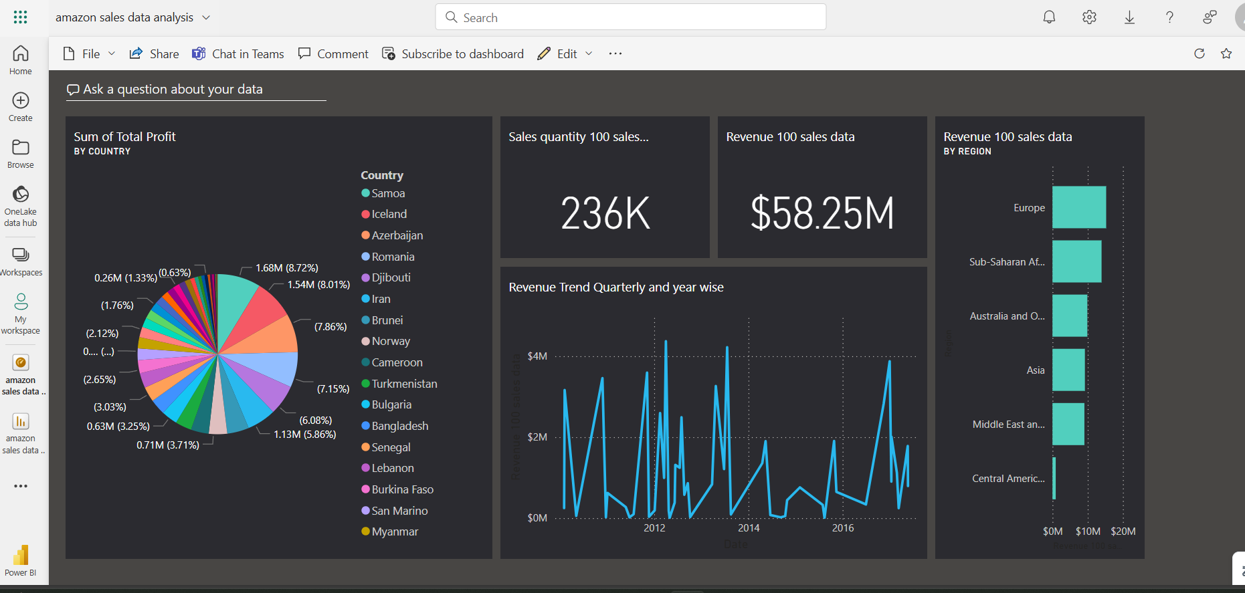

Slide 10
POWER BI DASHBOARD CREATION
n estimators: specifies the number of decision trees to be boosted. If n_estimator = 1, it means only 1 tree is generated, thus no boosting is at work. The default value is 100, but you can play with this number for optimal performance.
criterian: criterion is a loss function that is used to evaluate the performance of the model at each iteration and to guide the search for the optimal set of parameters
CV: cv refers to the number of folds used in cross-validation. The value of cv = 5 means that the data is divided into 5 equal parts, and the model is trained and evaluated 5 times, with each time one part being used for evaluation and the remaining 4 parts being used for training
Verbose: verbose determines the amount of information displayed while the model is training.

Slide 11
CONCLUSION
In conclusion, the data analysis of amazon sales was done on 3 different levels –sales key insights, food sales insights and food sales market. Extract-Transform-Load has been done and several key metrics, factors ,attributes and relationships have been generated using data modelling and data visualization in power bi desktop. The developed report was published to power bi service and corresponding dashboard was created

Slide 12
THANK YOU

